Slide 1
Open Government Partnership (OGP)
National Agency of State Property
Report on 2014-2015 Action Plan
Planning and Controlling Service
Strategic Development Department
January, 2016

Slide 2
2014-2015 Action Plan
Open Government Partnership (OGP)
Project financed through United Nations Development Programme (UNDP) which aims to ensure fulfillment of specific obligations by Government in order to increase transparency and accountability of state institutes, strengthen citizens and fight the corruption.
Commitments of 2014-2015 Action Plan adopted in the scope of the Project:
Improvement of public services
Advance management of public resources
Increase public involvement
Ensure secure environment
16 Entities are obliged to fulfill 27 specific commitments in order to achieve the aims

Slide 3
About Open Government Partnership
Involvement of LELP – National Agency of State Property in Open Government Partnership Programme
Obligation to implement the services of NASP in LEPL - Public Service Hall aims to perform the commitment of OGP to improve public services.

Slide 4
2014-2015 Action Plan
LEPL Public Service Hall covers large number of the public services. Its purpose is to issue documents and render services the exclusive right to which is owned by State. The State is committed to offer prompt, simplified and high-level services to each interested individual through the LEPL Public Service Hall. Delegating the services of NASP to the branches of Public service Hall is considered to be another important step taken in this regard.

Slide 5
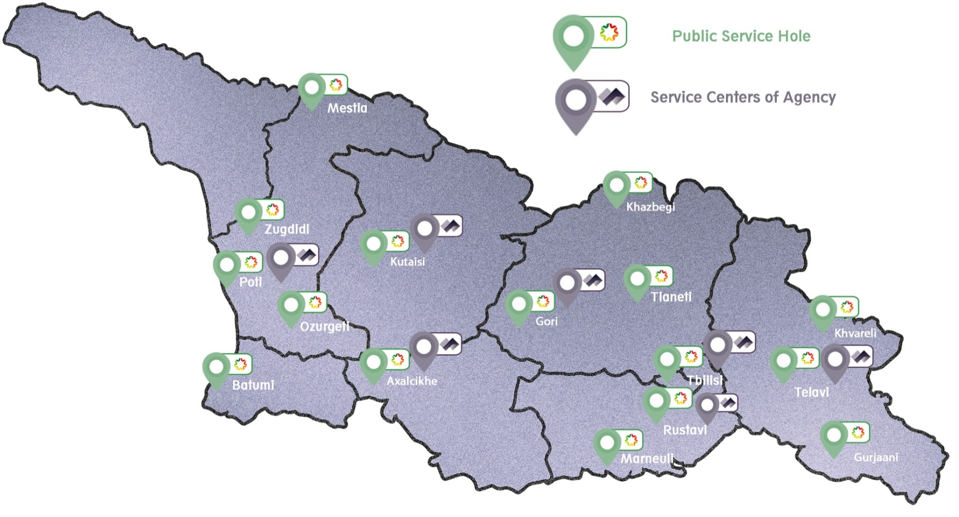
Importance of Project implementation
Implementation of services of NASP is expected to eliminate the distance and time problems for the citizens
15 branches of Public Service Hall
6 Service Centers of National Agency of State Property

Slide 6
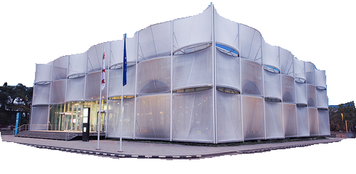
Implementation of obligations
on January 21, 2015 the Memorandum of Agreement was signed by the LEPL – Public Service Hall and by the LEPL - National Agency of State Property
Since January, 2015, In the scope of Agreement services of NASP have been provided in the Marneuli Branch of Public Service Hall in a pilot mode
Project activities:
Provide trainings and instructions to the employees of LEPL Public Service Halls
Raise awareness of society about the accessibility of services of NASP in Public Service Halls (production and distribution of informational-educational videos and informative material via Georgian Public Broadcaster and other commercial channels)

Slide 7
Importance of Project implementation
Since November 2, 2015, Each interested person has been granted an opportunity to take an advantage of services of NASP in all the branches of Public Service Hall
Citizens are given the opportunity to benefit the favorable services related to disposal of state property at convenient place.

Slide 8
Importance of Project implementation
Privatization by auction/direct selling or transfer with the right of use or management of registered/unregistered movable/immovable State property/shares/stakes
Apply the document confirming prepayment of 10% of initial price of property in order to ensure enouncement of auction
Confirmation of fulfillment of contractual obligation(s) related to the property purchased directly or through auction
Elimination of overlap between cadastral codes of private and state properties
Correction of errors in Ordinances of Government of Georgia about direct selling of state property
Defining the land plot to be assigned to the essential integral part of the land alienated by the government
Abolition of registration of State’s property right and repossession into private ownership
Issuing a consent on demarcation of property co-owned by the State and individuals and/or legal entities
Issuing a consent on change of the real property configuration alienated by the government authority
Issuing the State’s (as an owner/co-owner) consent
Issuing a consent on change of the area alienated by the government authority
Issuing a consent on mortgage of the real property alienated with conditions
Issuing a consent on unmerging/merging the real properties alienated with conditions

Slide 9
National Agency of State Property
LEPL – National Agency of State Property is still actively involved in OGP Georgian forum activities and continues efforts to increase transparency and accountability, to strengthen awareness of citizens and to fight the corruption.
Thank you for your attention

